Slide 1
6 Panchabanjan Kolkata
Brand Guidelines

Slide 2

Our Story
OUR HERITAGE
Our Name: Panchabanjan
Honoring the five essential spices, representing balance, warmth, and authenticity in Bengali cooking.
Culinary Heritage
Traditional Bengali recipes, passed down through generations, reimagined with a refined modern sensibility.
Memorable Dining
We preserve cultural gastronomy, offering an intimate journey into Kolkata's rich food culture.
Each Dish, A Story
Experience tradition, craftsmanship, and the vibrant flavors that define Bengali fine dining.

Slide 3




Brand Overview
Authentic Heritage
Refined Experience
Traditional Bengali recipes from generations of expertise.
Modern fine-dining, elevating traditional flavors.
Cultural Connection
Celebrate Kolkata's vibrant food culture.

Slide 4
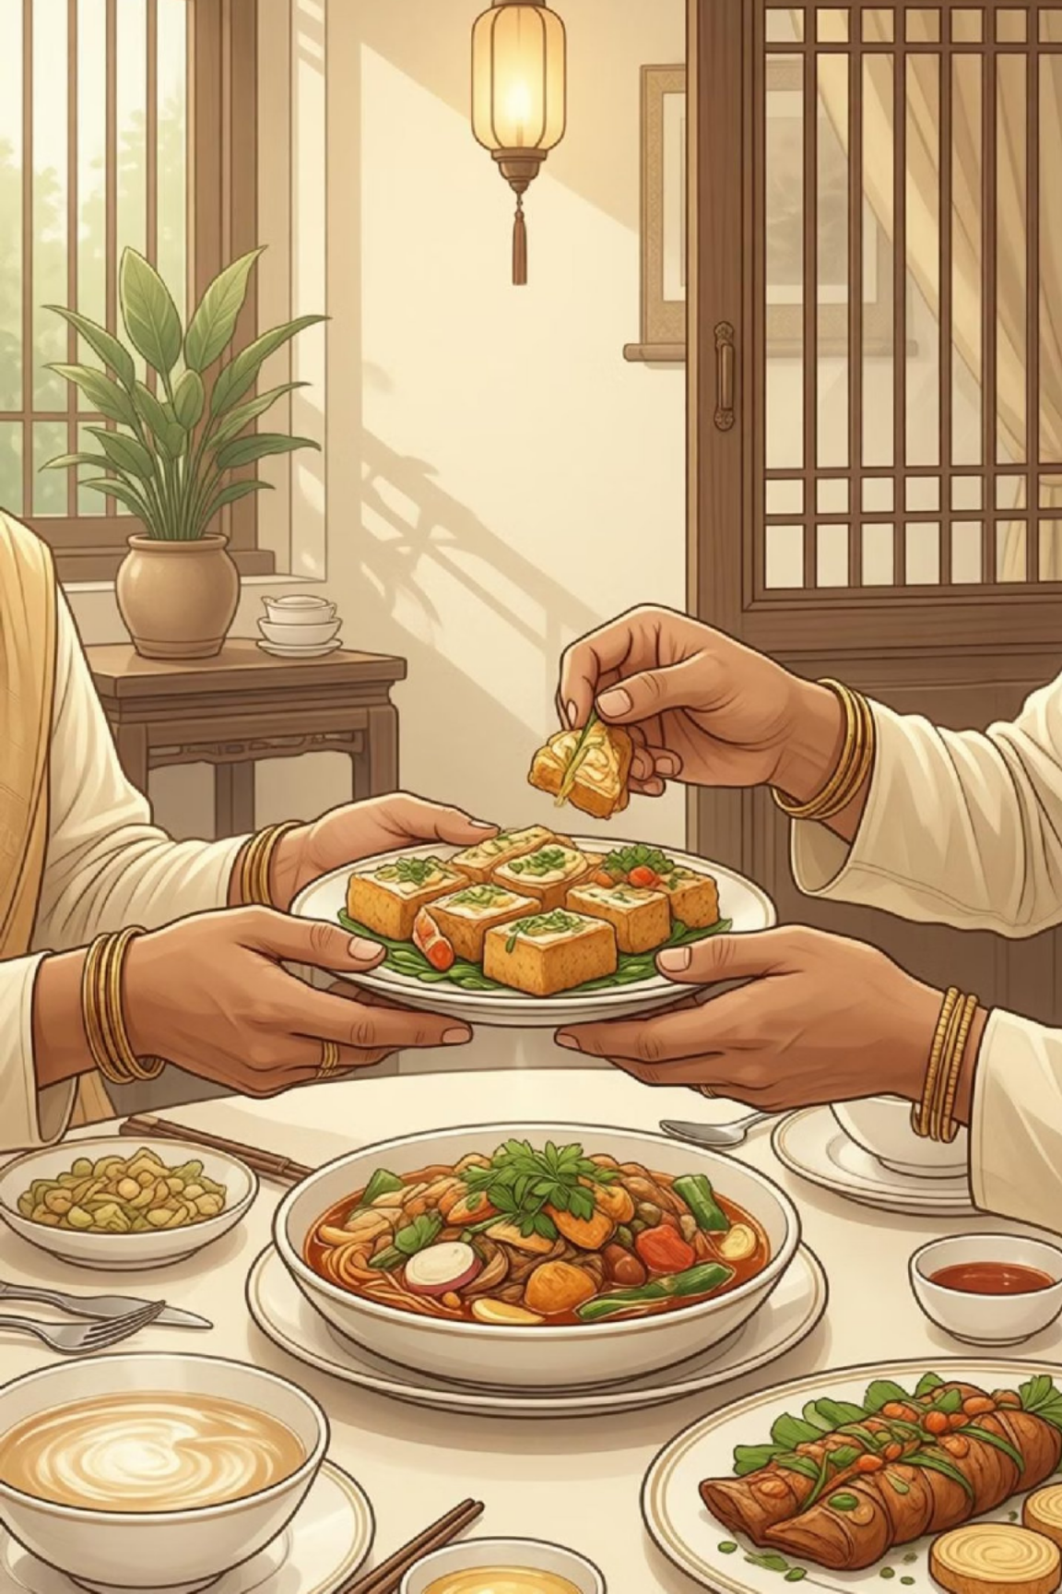


Brand Voice & Personality
HOW WE SPEAK
Our voice is warm, welcoming, elegant, and genuine, blending sophistication with approachability.
Warm and inviting, never pretentious
Knowledgeable yet accessible
Respectful of tradition with modern clarity
Sensory and evocative in descriptions
OUR PERSONALITY
We embody the spirit of Bengali hospitality—gracious, cultured, and deeply passionate about culinary artistry.
Elegant and composed
Culturally rooted and proud
Detail-oriented and thoughtful
Genuine and warm-hearted

Slide 5
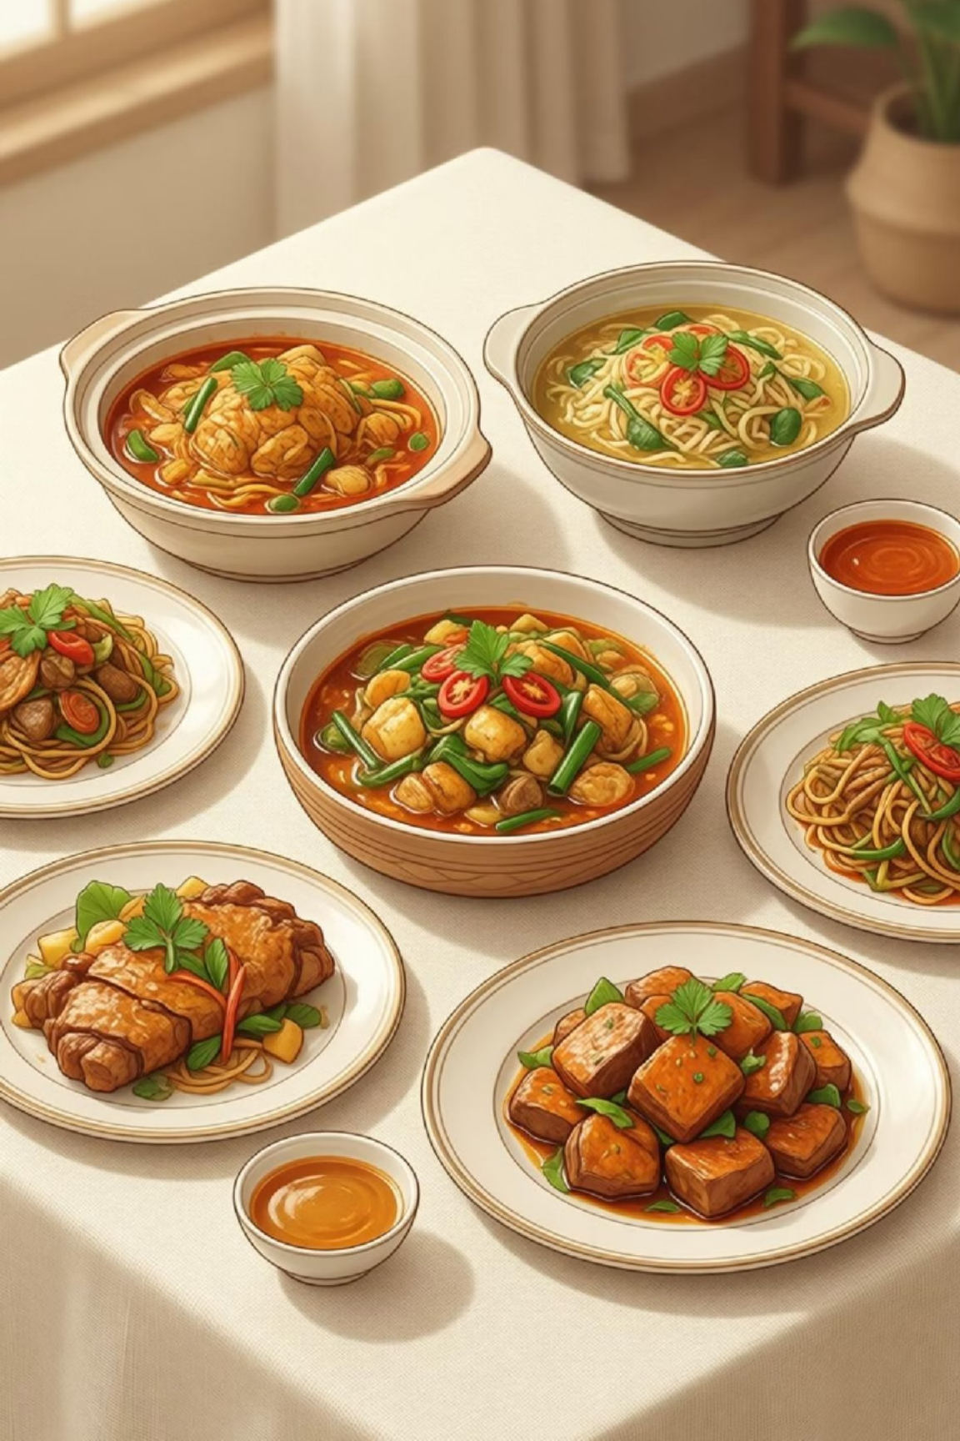
Mission & Vision
Our Mission
Preserve & elevate authentic Bengali cuisine.
Create exceptional dining experiences, honoring tradition.
Foster cultural appreciation through food.
Our Vision
Become the premier Bengali fine dining destination.
Known for culinary heritage & impeccable quality.
Connect guests to Kolkata's rich cultural tapestry.

Slide 6






Core Values
Authenticity
Honoring traditional recipes and cooking methods to preserve genuine Bengali flavors.
Excellence
Unwavering commitment to the highest quality in every ingredient and preparation.
Hospitality
Cultural Respect
Welcoming every guest with warmth and genuine care, creating comfort and belonging.
Celebrating and honoring Bengali heritage with reverence and pride for each tradition.
Thoughtful Innovation
Embracing modern presentation and refinement while deeply rooted in tradition.

Slide 7


Color Palette
Our palette evokes Bengali culture: earthy, refined, and inviting. It reflects traditional spices, handcrafted textiles, and heritage architecture.
Warm Sand
Soft Linen
#D3C5B6
#F2EBDF
Primary brand color for warmth and tradition.
Light background for elegance and spaciousness.
Golden Beige
#DECEBB
Accent color for richness and depth.
Use these colors for emphasis, backgrounds, borders, and accents. Maintain plenty of white space for a clean, sophisticated look.

Slide 8
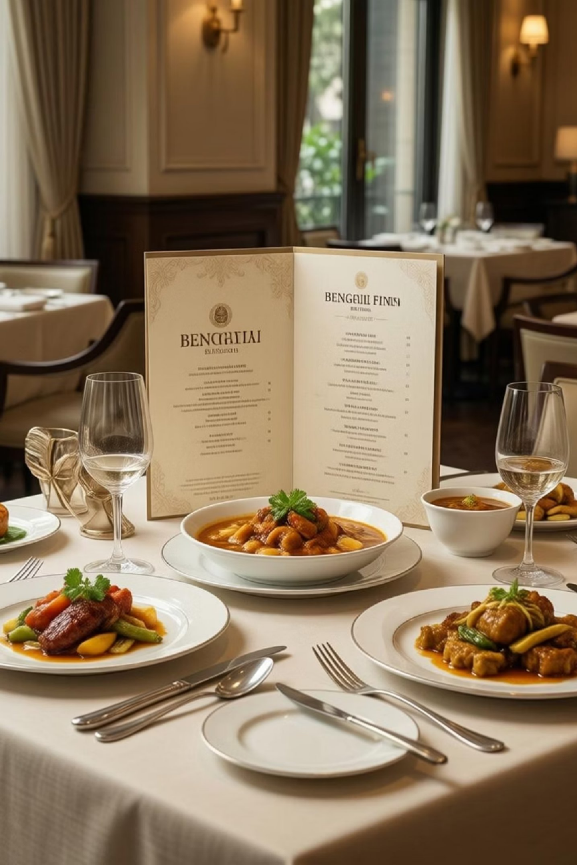


Typography Guidelines
Heading Typeface
Refined serif or elegant sans-serif fonts convey sophistication and cultural heritage.
Main titles & section headings
Timeless, distinctive feel
Creates visual hierarchy
Body Typeface
Clean, legible sans-serif or serif fonts ensure clarity and comfort for all body text.
Descriptions & body content
Ensures easy readability
Complements heading style

Slide 9
Imagery & Visual Style
Photography Style
Use natural, warm lighting. Images should feel authentic, inviting, and refined—never overly staged.
Cultural Elements
Incorporate subtle traditional motifs and textures from Bengali heritage without overwhelming the modern aesthetic.
Food Presentation
Showcase dishes with clean, elegant plating on neutral backgrounds, highlighting natural beauty and colors.
Color Treatment
Maintain warm, inviting palettes. Avoid harsh contrasts; keep the overall feeling light and approachable.

Slide 10

Thank You
6 Panchabanjan Kolkata
Good Food Good Mood

